Slide 1
Recognizing Tourism Opportunities in your Community
Rachael Carter
Mississippi State University Extension Service
Center for Government and Community Development

Slide 2
Tourism and Economic Returns
Public Budgeting Is Difficult
Tourism is Sometimes Misunderstood
Community Development is Vital – Public and private partnerships, community catalyst
Small towns have limited resources – Take advantage of what you have
Notes:
Decision making regarding public budgeting is difficult for elected officials due to limited resources.
Tourism is sometimes a misunderstood economic and community development tool. Local residents often can clearly see the burdens that tourism can place on a community, but may not be able to see the benefits such as revenue generation and job creation.
In order for any economic development strategy to be successful and sustainable community development must occur. This in the simplest of terms means that there must be a local person or entity that is the driving force behind the initiative. Also, people from various groups from within the community must work together towards a common goal.
Communities often have limited resources and must take advantage of what assets and resource that they do have in order to move forward.

Slide 3
Is this important?
Notes:
Ask the participants if tourism development is important to their community? Why do they think it is important. Why do they think it is not?

Slide 4
Tourism – The Basic Benefits
Tourism is an export good
Tourism brings visitors with higher disposable income to rural areas
Tourism can support more diverse retail
Tourism brings in outside revenues that stimulate the economy
Tourism enhances infrastructure, viability, and visibility
Tourism and Retail Development, Attracting Tourists to Local Businesses, Bill Ryan, Jim Bloms, Jim Hovland, David Scheler, University of Wisconsin Extension
Notes:
Explain to the audience that tourism has benefits because it is actually a good or service that brings in money from outside the local economy. Tourism can generate funding to support improvements to infrastructure. Tourism can also increase the visibility of the town and create an awareness of the resources the community can offer to both local and non-local residents.

Slide 5
Prairie Arts Festival
Notes:
The information in this slide are a calculation of direct expenditures that were experienced in a Mississippi town as the result of an event held in the community to draw in outside dollars and to celebrate the culture of the town. The event contributed to the local economy by brining in revenues from outside the local area and by encouraging spending by local residents when normally those local residents spend money in the larger surrounding communities.

Slide 6
Locals versus Tourists
Notes:
These charts represent the income levels of visitors and those from the local area to the Cotton District Arts Festival and Super Bulldog Weekend, that takes place in Starkville, Mississippi. The charts are significant because it is an example of a tourism event drawing visitors with higher income levels than the local residents to the area.

Slide 7
Community Events vs. Tourism Events
Which is it?
What is it?
Why are you doing it?
Notes:
Community events and tourism events are both important to the well being of a community, but the effects that they have on the community’s local economy vary. Community events typically have mostly attendees from within 50 to 90 miles of where they are being held. The benefits of a community event would be retaining local spending and contributing to the local quality of life.
Tourism events focus on drawing visitors from outside the local area to generate new money spending in the region. Tourism events can also create awareness about the resources, assets, or attractions of a particular town. An event can be both a community event and a tourism event, but it is vital that the event managers clearly define what they are outcomes they are trying to achieve when planning an event.

Slide 8
Questions to ask before getting started.
Why do I want to promote tourism and community development?
What assets do we have?
Who can help?
What are our goals and our market?
What current businesses/industries would benefit?
Is my community safe, friendly, and attractive?
Notes:
Event planners need to make decisions about staffing an event prior the implementing the event. Determining what groups could be potential volunteers is a good way to build capacity for the event.
Event planners need to determine a what type of people they are trying to draw to their event, how many people they believe will attend, and what businesses would benefit from the event.

Slide 9
How Does this Fit in My Community?
What are Complimentary Businesses?
What is My Community Culture?
Is My Community Suitable for Tourism?
What Facilities, Resources, Amenities, and People are Available?
Notes:
It is common for a community to not be an ideal location for tourism. Sometimes the local residents do not want visitors in their town for various reasons. It is important to ask questions such as would tourism be accepted in my community and achieve buy-in prior to organizing and event.

Slide 10
What does a tourist need?
Eat
Sleep
Do
Buy

Slide 11
Industry Sectors Impacted by Tourism
Hotels
Bed and Breakfasts
Agriculture
Retail and Small Businesses
Healthcare
Restaurants
Oil and Gas
Construction
Transportation
Local Government
Notes:
These are some of the industries impacted by spending as the result of tourism. It is easy to understand that retail, hotels, and restaurants are all impacted by tourism, but it takes more thought to consider that tourism can also benefit agriculture, oil and gas, and construction industries.

Slide 12
Tourism Businesses
Hotels
Restaurants
Bed and Breakfasts
Campgrounds
Outfitters
Music Venues
Museums
Sports Facilities
Equipment Rentals
Art Galleries
Farms
Casinos
Amusement Parks
Race Tracks
Guide Services
Theatres
Notes:
These are basic examples of tourism businesses in a local community. These businesses can either generate their own tourists or benefit from tourism.

Slide 13
Types of Rural Tourism
Agritourism
Farm Tours
Petting Zoos
Tractor Shows
Rodeos
Trail Rides
Historical Tourism
Museums
Story Telling
Indian Mounds
Battlefields
Ecotourism/Nature Tourism
Canoeing
Bird Watching
Butterfly Watching
Fee Hunting & Fishing
Sports Tourism
Large Sporting Events
Travel Tournaments
Professional Matches and Tournaments
Runs or Benefits
Music Tourism
Large Music Events
Small Venues
Music Festivals
Music Museums
Festival and Special Events
Arts Festivals
Street Fairs
Community Events
Music Festivals
Auctions, Yard Sale, Flea Market
Wildlife Festival
Culinary Tourism
Restaurants
Local Foods
Festivals the Promote Foods (Sweet Potato)
Niche Tourism
Conference
Reunion
Holiday
Weddings
Anniversaries
Notes:
This diagram shows various types of rural tourism and how each of these types of tourism is often not a stand alone in a tourism mix or package in a community. Sports tourism and culinary tourism could be tied together to create an experience. A simple example would be attending a sporting event and then dining at a local restaurant that specializes in local cuisine.

Slide 14
The Unusual
Haunted Cemetery Tours
Crop Dusters
Movie Site Tours
Coon Dog Cemetery
Nostalgia
Notes:
When creating a tourism attraction authenticity is important. Ask questions such as what makes our community special. Is this a story we could tell. How can we make some of our everyday cultural experiences an attraction for a tourist.

Slide 15
Potential Growth and Trends
Local Foods
Historical Tourism
Arts and Culture
Adventure
Sports
Ecotourism
Agritourism
Family Reunions
Conferences
Education
Religion
Rails, Trails, and Farm Experience
Holiday Tourism
Fee Hunting & Fishing
Notes:
This is a list of established and emerging trends in tourism and travel today. The purpose of this list is to allow the audience to brainstorm on what assets in their community would fit into one of these categories. For example if the community has a local river that would be a resource for developing adventure tourism with canoe rentals or ecotourism with river tours.

Slide 16
Highways, Byways, Rivers, Trails, and Tracks (Capitalizing on existing strategies, markets, and attractions)
Think of Major Highways
Already Created Trails
Railroads
Rivers and lakes, and Gulf Coast
Airports
Tourism Trails are Trending
Notes:
Consider that modes of transportation can impact the number and type of tourists that visit your community. Modes of transportation can also be a form of a tourism attraction.
Suggest that the audience research all of the major transportation avenues to their community or near their community. This information can be used to determine where and how to market your attractions. This information can also be used to determine what types of tourists might be traveling through your town already. Place information about your events where these travelers will easily find it.
Many states have already developed marketing strategies and attractions around attractions such as rivers, lakes, and railroads. The audience should research whether there are any initiatives currently underway in their community.
The development of nature based and culture based trails has become popular in multiple states. The audience should be advised to determine if any of these initiatives are currently taking place in their region and develop a strategy to use this existing marketing to benefit their event or attraction.

Slide 17
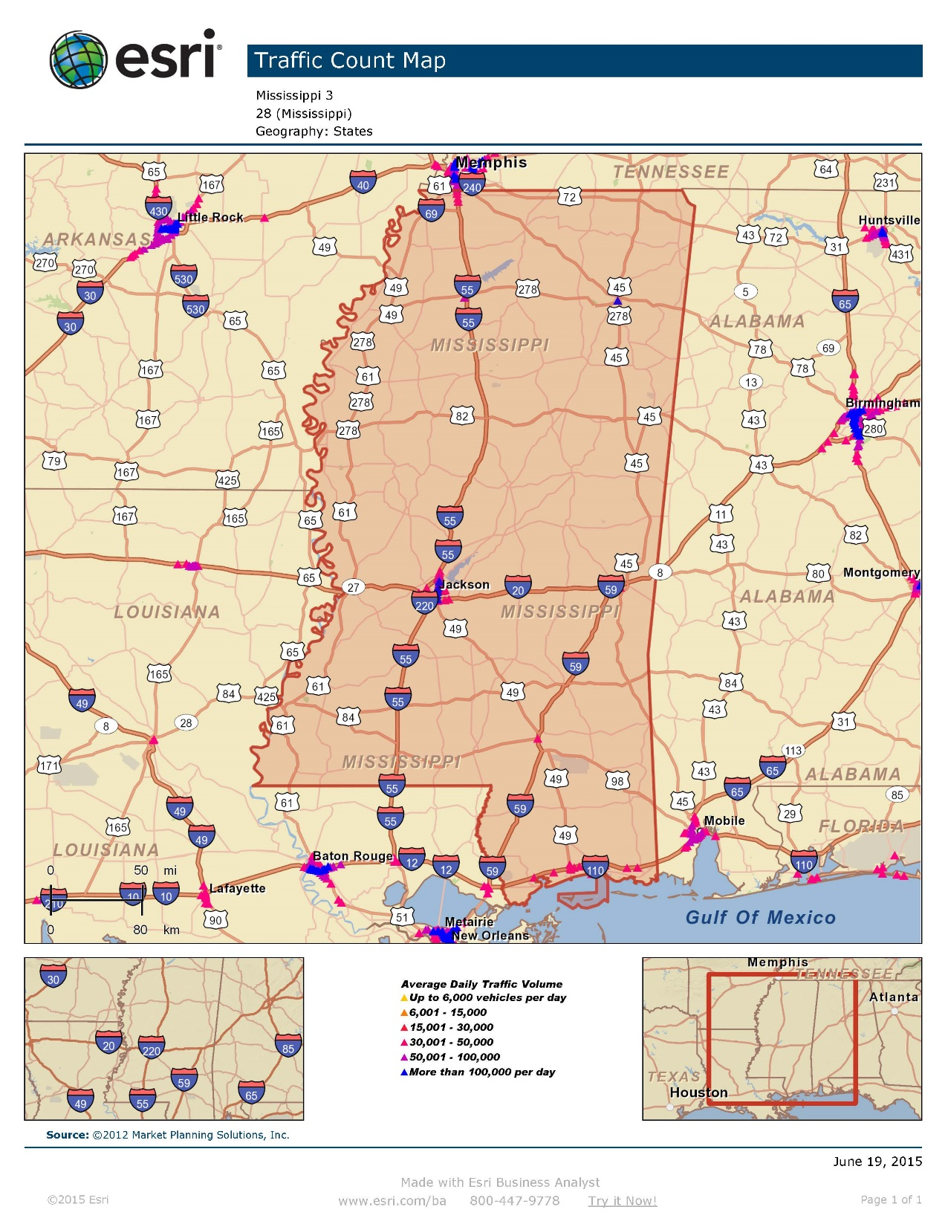
Notes:
ESRI is a method that can be used to identify well traveled roads and highways near your community.

Slide 18
Barriers and Challenges
Funding
Lack of Support
Lack of Understanding
Lack of Enough Resources
Notes:
The most common challenges and barriers to success when developing tourism are listed on this slide. As an activity have the group create a list of potential funding resources for tourism development. The group also needs to develop a communications plan for building support for their tourism attractions and events.

Slide 19
Vital To Success
Community Catalyst
Access to Resources and Opportunity
Building Relationships
Public and Private Partnership
Knowing Your Market

Slide 20
Let’s Talk About the Team
NOTE:
To change images on this slide, select a picture and delete it. Then click the Insert Picture icon
in the placeholder to insert your own image.
You make it what you want it to be
Notes:
It is vital when creating a sustainable tourism effort that you build a team. Relationships within the community and outside the community contribute to the success of any event.
Ask the group to discuss potential partners for their tourism efforts.
Positions that would need to be filled would need to include an event board. For example create a formal group to manage a specific event. Board members need to be assigned to the focus areas in which they feel most comfortable. Specific areas would be marketing, entertainment, logistics, safety, food and beverages, programming, administration, and sponsorship.
Also, consider developing a plan for establishing community partners within public and private organizations such as public offices, emergency management, local businesses, and community groups.

Slide 21
What to eat?
Notes:
The following slides are an activity. It is common knowledge that tourists need a means to travel to your community, something to eat, somewhere to sleep, something to do, and something buy.
In order to get the group started in creating a tourism experience have the audience name somewhere in their region that they love to eat, a means of transportation, somewhere to stay, and something to do in their region. This information could possibly be used to develop guides of things to see and do in the area. It could also be used to help build weekend getaways, and day trip attractions.
Ask the audience to be creative, and to list places that are not as well known or that creates a particularly good experience for a visitor.

Slide 22
What to do?

Slide 23
How to get there?

Slide 24
Resources and Links
Tourism and Retail Development, Attracting Tourists to Local Businesses, Bill Ryan, Jim Bloms, Jim Hovland, David Scheler, University of Wisconsin Extension

